Slide 1
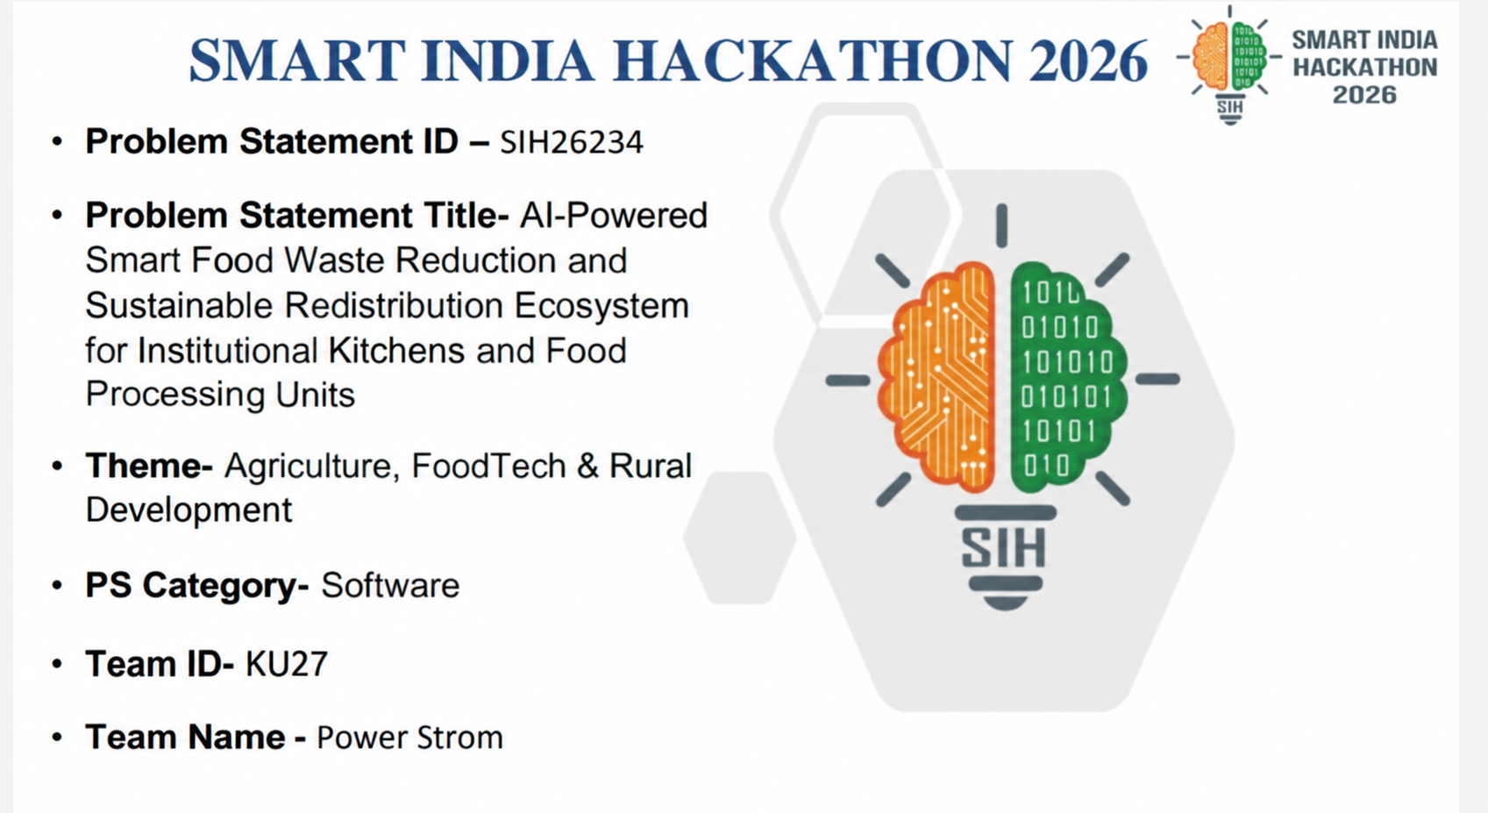



Slide 2

Power Strom
SOLUTION OVERVIEW
EcoFeast — "Save Food. Connect Communities. Create Impact."
Smart surplus-food redistribution platform for institutional kitchens and food processing units: safety verification, NGO matching, pickup, traceability and impact.
Responsible Positioning
Coordination and decision-support tool. It does NOT certify food safety and does NOT replace FSSAI licensing, hygiene norms or on-ground checks. Only food that passes digital HACCP checks is offered for human consumption; unsafe food is condemned and routed to compost/biogas.
Four Core Modules
Surplus Listing & Safety
Smart Match & Dispatch
Traceability & Pickup
Impact & Leaderboard
Kitchens log batches with quantity, storage method and prep window; digital temperature and seal checks.
Ranks nearby NGOs by distance, expiry, storage fit and capacity; volunteer van dispatch.
Immutable event timeline from kitchen to plate; handover handshake and status updates.
Meals served and CO2e avoided (estimates); sustainability leaderboard and admin audit feed.
Smart Matching Engine (Transparent, 100 points)
Waste Hierarchy (Sustainability)
Distance 40 | Expiry urgency 30 | Storage compatibility 20 | NGO capacity 10
Explainable scoring: every match is justified to kitchen and NGO (no black box)
Feed people first: rescue verified-safe surplus
FPU surplus upcycled into shelf-stable rations
Unsafe/expired food to compost/biogas
~1.05 billion tonnes of food wasted globally in 2022 (UNEP Food Waste Index 2024)
@SIH Idea submission- Template
2

Slide 3
Power Strom
TECHNICAL APPROACH
Proposed Technology Stack
Architecture & Data Flow
Frontend - React + TypeScript + Vite + Tailwind
Backend - Node.js + Express
Database - Supabase PostgreSQL (Row Level Security)
AI - Gemini API (server-side)
Charts - Recharts; routing - role-guarded React Router
Hosting - Vercel
Kitchen logs surplus with quantity, storage method and safe-till time
Digital HACCP check (temperature, seal); unsafe batches are locked
Matching engine ranks nearby NGOs; accept in one tap
Volunteer van dispatched; status updates and handover handshake
Meals and CO2e logged to the impact ledger
Unsafe or expired items routed to compost/biogas
AI / ML Components - stated accurately
Security & Compliance
Assistant: Gemini-powered, server-side; advisory only
Matching: deterministic weighted scoring (explainable), not a trained model
Safety: hot-hold above 60°C, cold-hold below 4°C, danger-zone timer; never a safety guarantee
Role-based access (kitchen / FPU / NGO / admin) with Supabase Row Level Security
Server-side API keys; immutable traceability audit timeline
Aligned to DPDP Act 2023 (formal review planned)
Aligned to FSSAI Food Recovery & Distribution Regulations, 2019 (expert review pending)
@SIH Idea submission- Template
3

Slide 4
Power Strom
USERS, ACCESS & IMPACT DESIGN
Who Uses It
Impact Monitoring & Dashboards
Institutional kitchens
Food processing units (FPUs)
NGOs
Admin
Meals supported: 1 kg rescued food ≈ 2.5 meal portions (400 g)
CO2e avoided: 1 kg rescued ≈ 2.5 kg CO2e (estimate)
Kg rescued, platform velocity SLAs, match accuracy
National sustainability leaderboard
Aligned to UN SDG 2, 12 and 13
Figures are estimates based on stated conversion factors
Future Scope (not in prototype)
Bhashini voice
Offline sync and SMS fallback
Demand forecasting
@SIH Idea submission- Template
4

Slide 5
Power Strom
FEASIBILITY & DIFFERENTIATION
How This Differs (verify vs. current competitor features)
Roadmap
Dimension | Typical Apps | EcoFeast
Food safety | Self-declared | Digital HACCP temperature and seal checks
Matching logic | Manual / first-come | Distance + expiry + storage + capacity score
Full-chain coverage | Donation only | Rescue + FPU upcycling + compost + impact
Traceability | Limited | Immutable kitchen-to-plate event timeline
Institutional focus | Restaurants, individuals | Kitchens and food processing units
Phase 1 - Prototype (done): kitchen, FPU, NGO and admin roles, matching engine, traceability, impact dashboard
Phase 2 - Pilot: one city, ~10-20 kitchens and ~5 NGOs; engage a food-safety advisor; measure meals saved
Phase 3 - Scale: multi-city rollout, municipal and CSR partnerships, FSSAI Save Food Share Food integration, formal DPDP review, voice and offline access
Honest Limitations
No FSSAI / food-safety expert engaged yet; safety checks are advisory
Impact figures and matching not yet validated with real pilot data
Depends on kitchen and NGO adoption; liability and hygiene norms need legal review
@SIH Idea submission- Template
5

Slide 6
Power Strom
RESEARCH, TEAM & STATUS
Research & Reference Links
Team - Power Strom
FAO - Food Loss and Waste
Apsa Muskan (Team Leader)
Research Link - FAO
Research, documentation, presentation lead
UNEP - Food Waste Index Report 2024
A. Beebijan
Research Link - UNEP
Backend and matching logic
UN SDG 12.3 - Halve Food Waste
V Omkar
Research Link - UN SDGs
Frontend / UI implementation
FSSAI - Food Recovery & Distribution
Rajesh
Research Link - FSSAI
API integration, NGO & admin dashboard
Prototype Status
Deepak G
MVP built: kitchen, FPU, NGO and admin roles; matching engine; traceability; impact dashboard
Live prototype (one-click demo logins on /login)
Repo: github.com/Beebijan-cse/SIH_ECOFEAST
Database, QA, deployment
M Khusro Nawaz Nizami
Research & domain study, UI/UX support
@SIH Idea submission- Template
6

